Slide 1
ESFP-2 PROJECT :- MOVIE TICKET BOOKING

Slide 2
FIRST IT WILL ASK BELOW
int n;
string films;
string greet;
string amount;
cout<<"\t\t---Welcome--\n"<<endl;
m:
cout<<"\t\tPress 1 -> For Available Movies\n";
cout<<"\t\tPress 2 -> For Available Movie Seats\n";
cout<<"\t\tPress 3 -> For book films Ticket\n";
cout<<"\t\tPress 4 -> To Get Safe Exit"<<endl;
cout<<"Press From Above Content: ";
cin>>n;

Slide 3
SWITCH CASE : 1
case 1:
{
// number of movies.
cout<<"\tCaptain marvel"<<endl;
cout<<"\tKGF Chapters"<<endl;
cout<<"\tRRR"<<endl;
cout<<"\tHulk"<<endl;
cout<<"\tThor"<<endl;
goto m;
}

Slide 4
SWITCH CASE : 2
cout<<"\nMovie name ? ";
cin>>films;
cout<<"\n\nEnter Movie Quality 4K OR 1080p: ";
cin>>greet; // example 4K;

Slide 5
For kgf movie
if(films == "kgf chapters")
{
cout<<"Seats Available 50 out of 150"<<endl;
if(greet == "4k")
{
cout<<"\nPrice For 4K "<<films<<" is: 799 Rupee"<<endl;
cout<<"\nEnter YES for payment Proccess: ";
cin>>amount;
if(amount == "yes")
{
cout<<"\nPayment Recieved for - "<<films<<endl;
}
else if(amount == "no")
{
goto m;
}
}

Slide 6
For iron man movie
else if(films == "iron man")
{
cout<<"Seats Available 45 out of 150 "<<endl;
if(greet == "4k")
{
cout<<"\nPrice For 4k "<<films<<" is: 999 Rupee"<<endl;
cout<<"\nEnter YES for payment proccess: ";
cin>>amount;
if(amount == "yes")
{
cout<<"\nPayment Recieved for - "<<films<<endl;
}
else if(amount == "no")
{
goto m;
}
}

Slide 7
Thor movie
else if(films == "thor")
{
cout<<"Seats Available 80 out of 150"<<endl;
if(greet == "4k")
{
cout<<"\nPrice For 4k "<<films<<" is: 699 Rupee"<<endl;
cout<<"\nEnter YES for payment proccess: ";
cin>>amount;
if(amount == "yes")
{
cout<<"\nPayment Recieved for "<<films<<endl;
}
else if(amount == "no")
{
goto m;

Slide 8
For hulk movie
else if(films == "hulk")
{
cout<<"Seats Available are 67 OUT of 150"<<endl;
if(greet == "4k")
{
cout<<"\nPrice For 4k "<<films<<" is: 1199 Rupee"<<endl;
cout<<"\nEnter YES for payment proccess: ";
cin>>amount;
if(amount == "yes")
{
cout<<"\nPayment Recieved for "<<films<<endl;
}
else if(amount == "no")
{
goto m;

Slide 9
For captain marvel
else if(films == "captain marvel")
{
cout<<"Seats Available are 23 OUT of 150"<<endl;
if(greet == "4k")
{
cout<<"\nPrice For 4k "<<films<<" is: 799 Rupee"<<endl;
cout<<"\nEnter YES for payment proccess: ";
cin>>amount;
if(amount == "yes")
{
cout<<"\nPayment Recieved for "<<films<<endl;
}
else if(amount == "no")
{
goto m;
}

Slide 10
For need for speed movie
else if(films == "need for speed")
{
cout<<"So Sorry!! for Inconvinance: ZERO Seats!!"<<endl;
goto m;
}
else
{
cout<<"\nPrice for 1080p "<<films<<" is: 499 Rupee"<<endl;
cout<<"\nEnter YES for payment proccess: ";
cin>>amount;
if(amount == "yes")
{
cout<<"\nPayment Recieved for "<<films<<endl;
}
else if(amount == "no")
{

Slide 11
IF NO MOVIE AVAILABLE
else
{
cout<<"Thus!! No Movie available"<<endl;
}
goto m;
}

Slide 12
SWITCH CASE 3
case 3:
{
cout<<"\n\t\t_Ticket_Details_"<<endl;
cout<<"\tYour Movie Show:- "<<films<<endl;
cout<<"\tMovie Available In:- "<<greet<<endl;
cout<<"\tPaid Successfully:- "<<amount<<endl;
cout<<"\tMovie show timing will be conclude soon..";

Slide 13
FILE HANDLING
ofstream creation;
creation.open("project_movie.txt", ios::out); // creating files
// inserting details into file. named:- "project_movie.txt".
creation<<"\t\tYour MOVIE DETAILS\n";
creation<<"\tYour Movie Show:- "<<films<<endl;
creation<<"\tMovie Available In:- "<<greet<<endl;
creation<<"\tPaid Successfully:- "<<amount<<endl;
creation<<"\tMovie show timing will be concluded soon..";
creation.close();
goto m;

Slide 14
SWITCH CASE 4
case 4:
{
cout<<"\nHope You Enjoyed...."<<endl;
break;
}

Slide 15
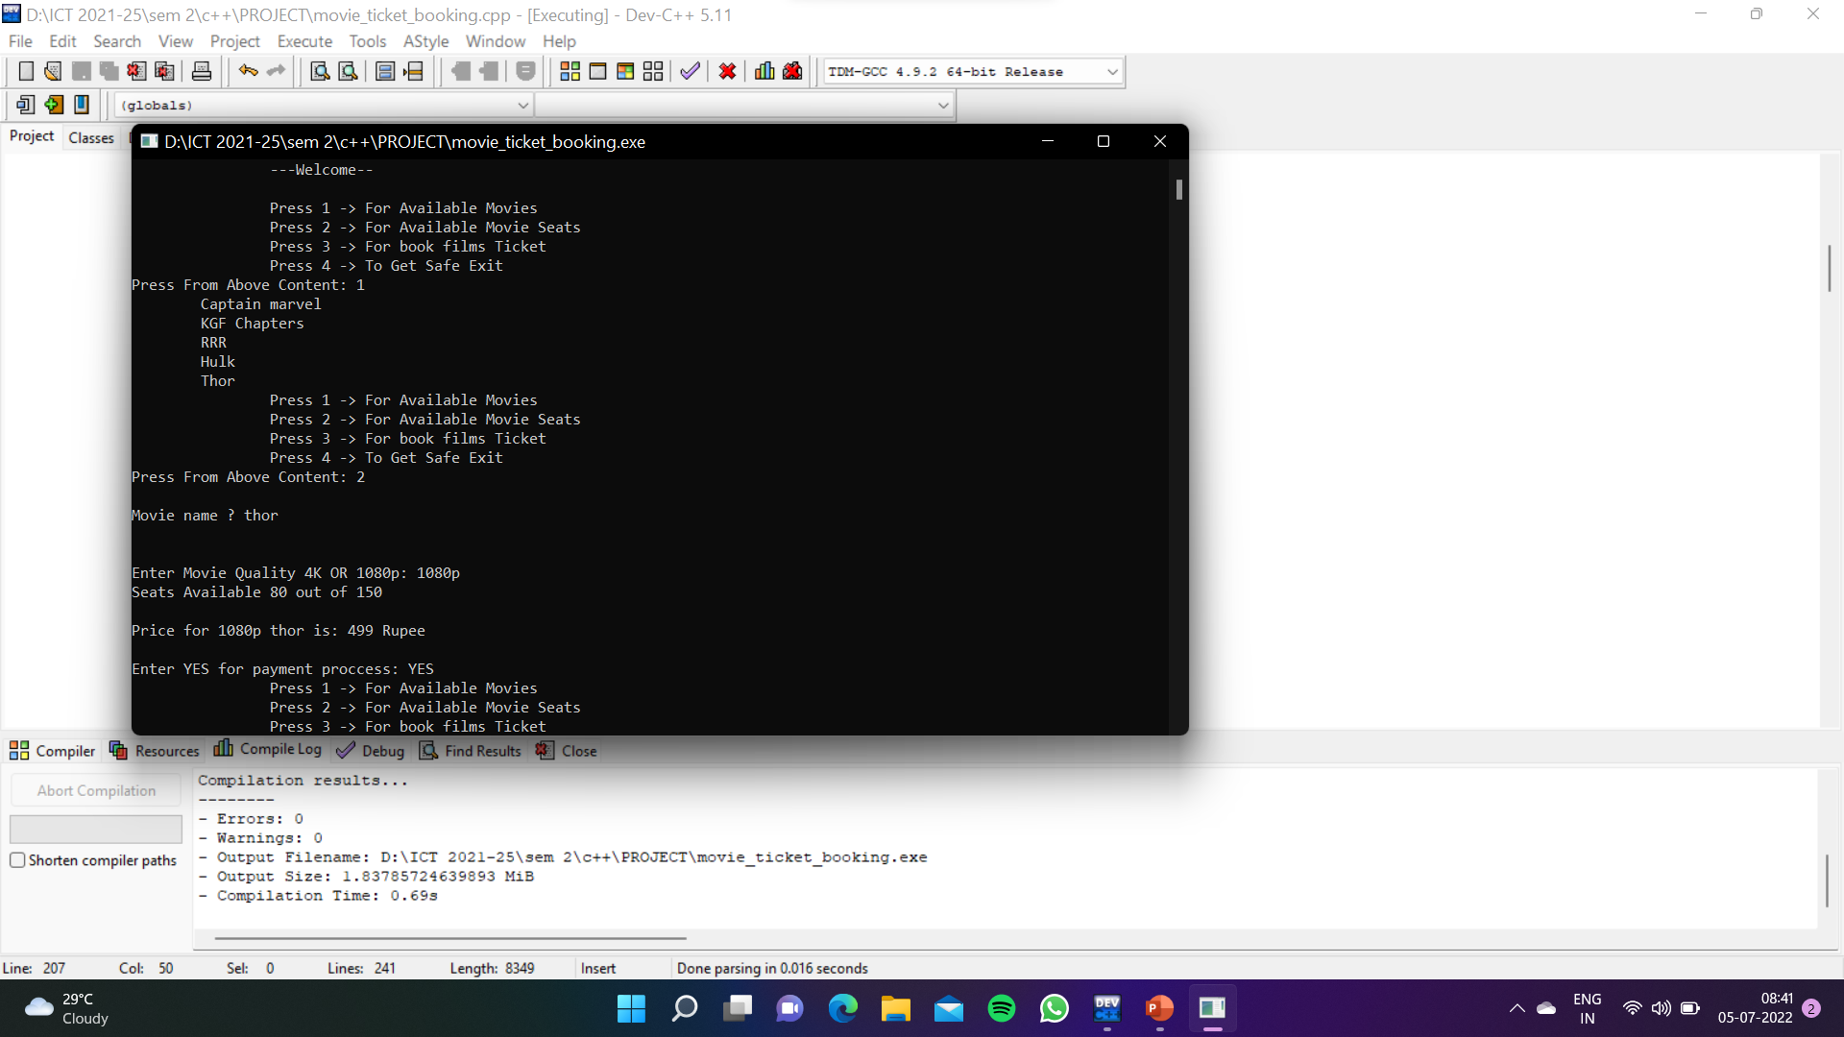

Slide 16
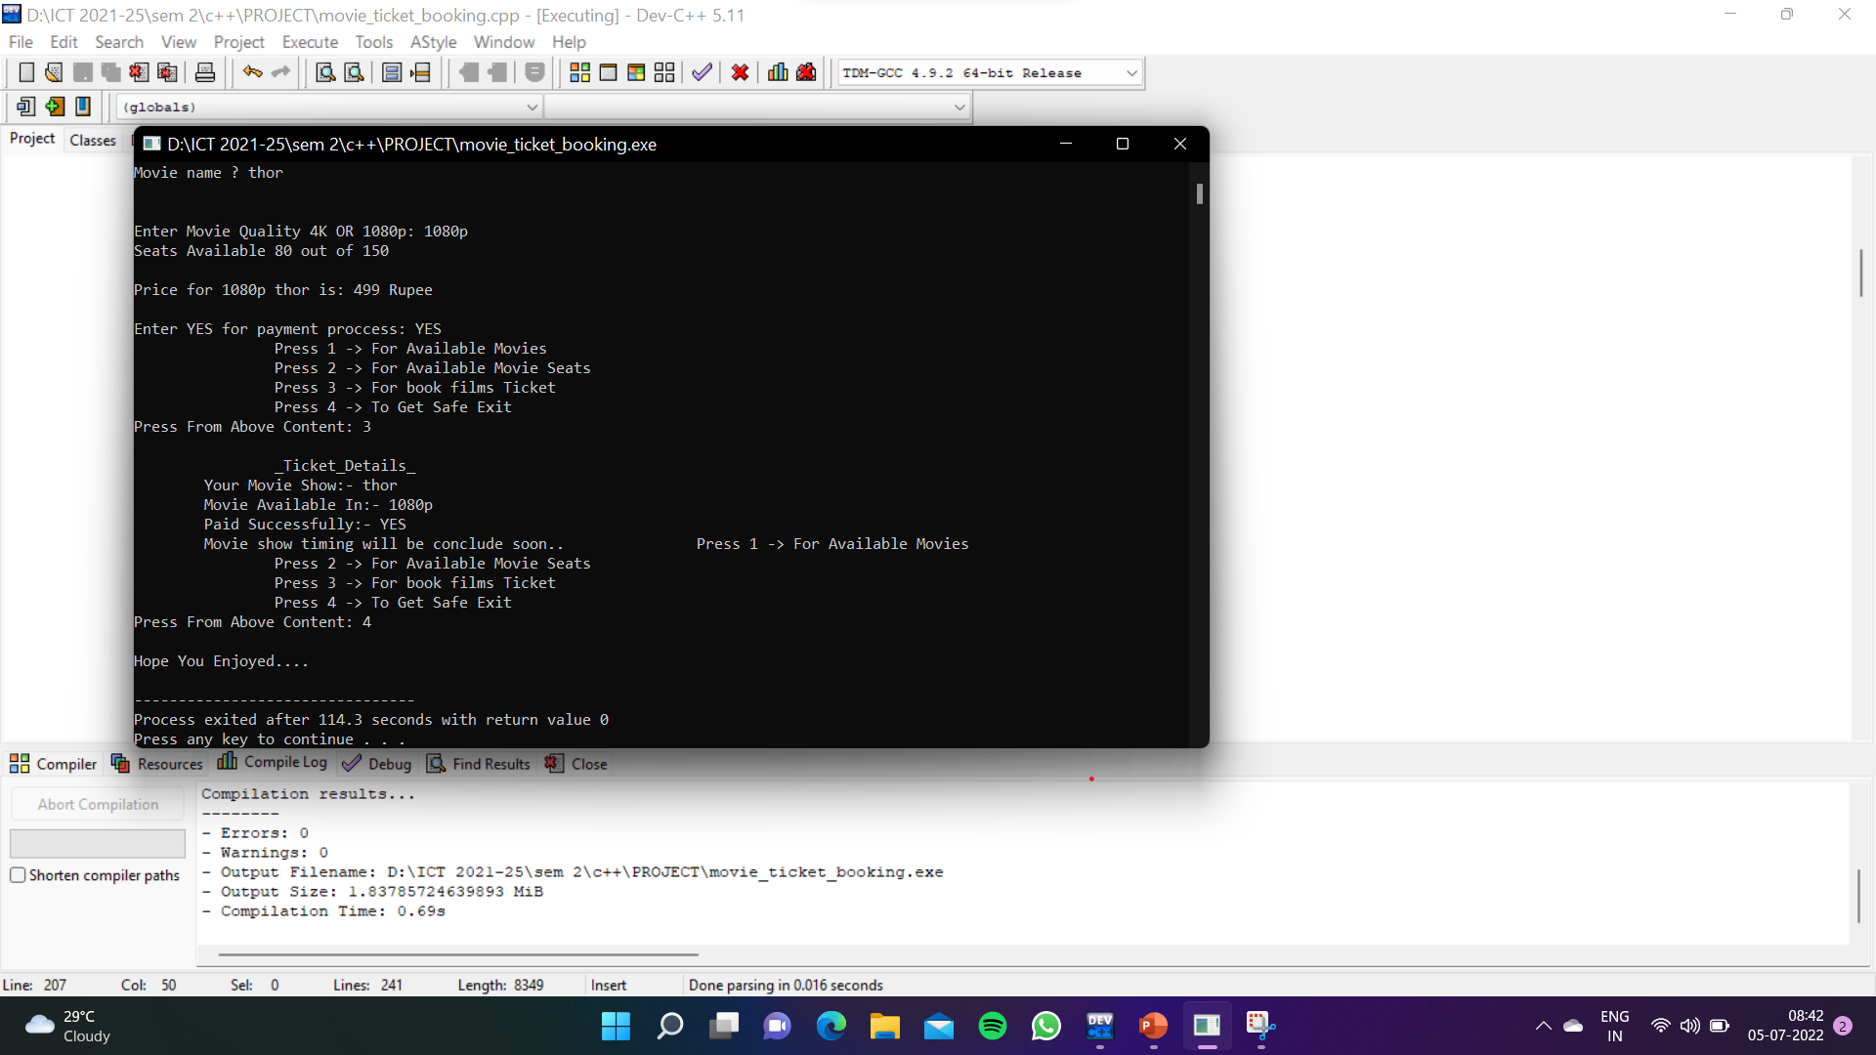

Slide 17
